Slide 1
VISUALIZATION TASKS Case study (part 1)
File created on: 6/5/2022 6:21:42 AM Tableau Public Dashboard Link -
https://public.tableau.com/app/profile/sana.tahasildar

Slide 2
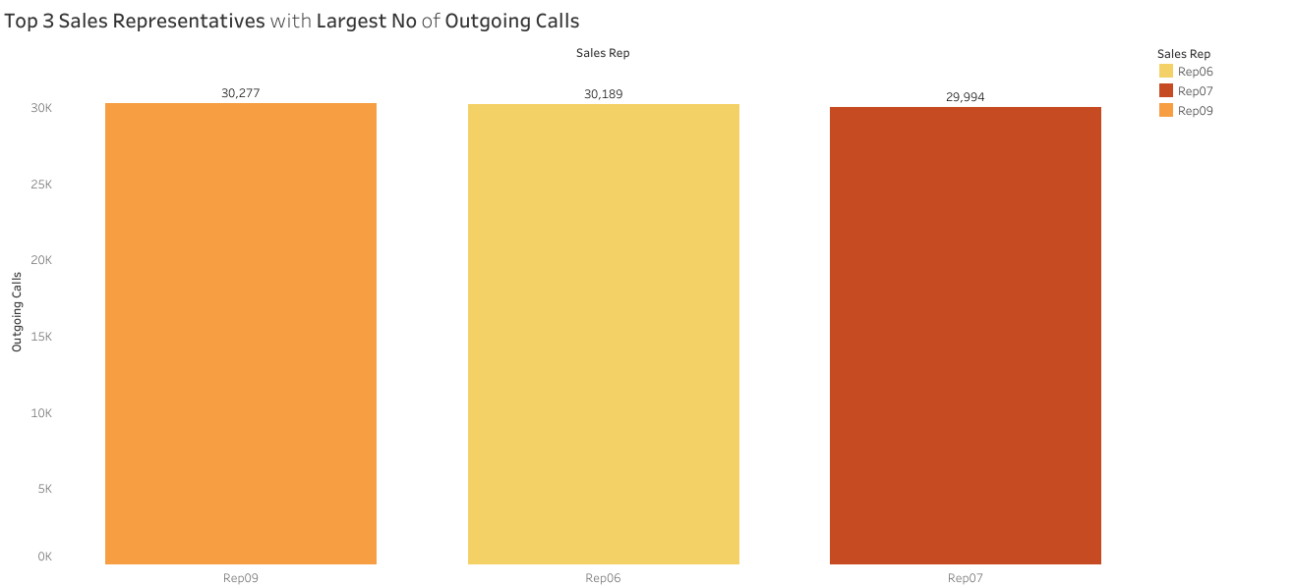

Slide 3
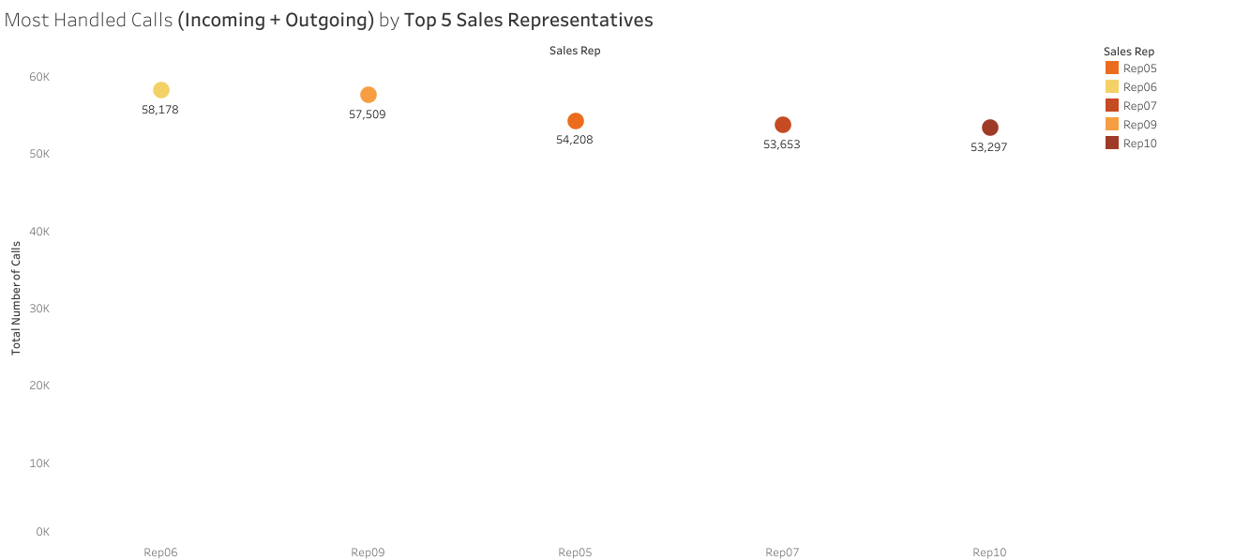

Slide 4
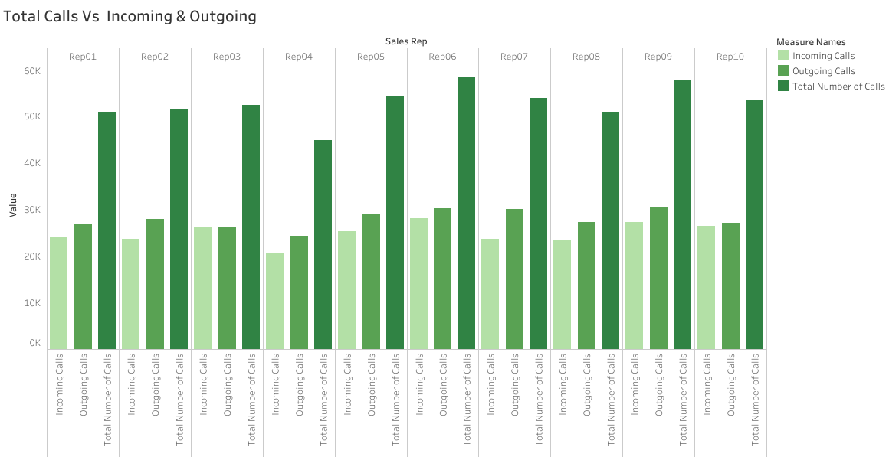

Slide 5
